Slide 1
EXPERIENCE STORY
Accelerating Bioenergy Adoption
Opportunities in steel decarbonization
futurescalex.com
contact@futurescalex.com

Slide 2
Experience story: A major steel producer aimed to adopt bioenergy as a key lever to decarbonize steelmaking operations
SITUATION
1
A major steel producer targets decarbonization of existing assets as part of its global Net Zero 2050 commitment. The client views bioenergy as a key lever to decarbonize steelmaking operations especially considering uncertainties in DRI-hydrogen route.
CHALLENGE
2
Evaluating ‘Primary-buy, opportunistic-make’ operating models to establish profitable business cases for biochar, biocoke, pyro oil, and biogas portfolio as an independent P&L.
SOLUTION
3
Developed a stage-gate framework to secure biofeedstock and technology, build the business case, and define the GTM strategy. The approach encompassed opportunity analysis, feasibility studies on techno-economics and supply chain, and strategic planning with partner due diligence and adoption roadmap.
IMPACT
4
Proposed suitable bio-feedstocks along with innovative pretreatment and conversion technologies delivering comparable purity, mechanical strength, process yield, and economic scale to coking and pulverized coal. Recommended optimal partners for securing biofeedstock, technology, and offtake of liquid and gaseous side-streams, enabling a profitable mid-term business case for managing the bioenergy portfolio.

Slide 3
The solution framework
OPPORTUNITY SCREENING
Assess feedstock options: physicochemical factors, volume availability and price
Screen technology options: novelty, maturity, and access
Contextualize industry best practices
STEP 3
STEP 1
STEP 2
Clearly defined pathway to unlock growth opportunities in all credible supply chain and techno-economic scenarios
Accelerating bioenergy adoption
GO-TO-MARKET STRATEGY
GO, NO-GO, SLOW-GO DECISION
Select relevant go-to-market partners through in-depth pre-due diligence
Develop new business model
Design go-to-market roadmap
Establish techno-economic feasibility
Develop S-curve scenarios on economic viability and scale
Determine supply chain readiness
Assess future risk-reward scenarios

Slide 4
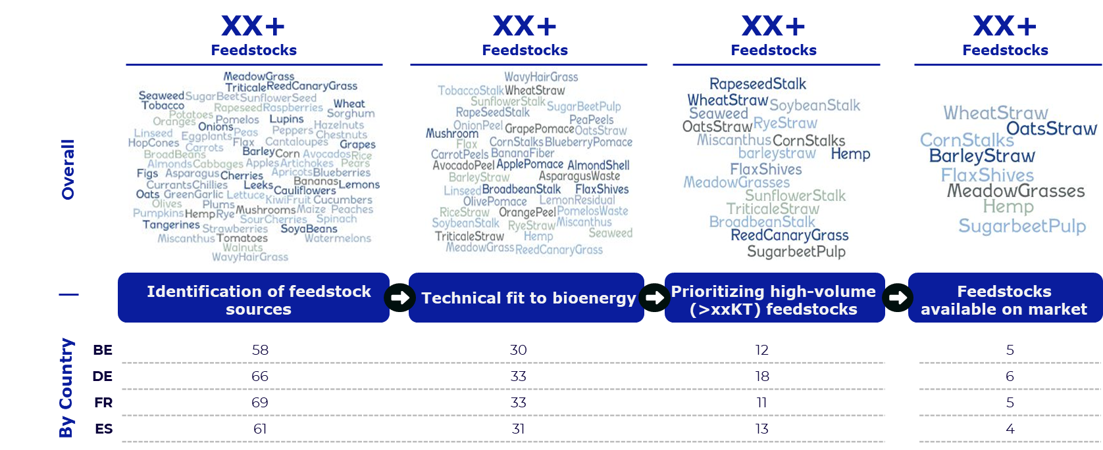
Step 1: Opportunity screening
Feedstock selection for bioenergy
Arrived at final shortlist of feedstock matching technical and volume needs, leveraging proprietary FSX BioScaleX portal covering 100+ biomasses in 60+ countries globally.
SAMPLE OUTPUT

Slide 5
Step 1: Opportunity screening
Technology and ownership assessment
Identified attractive technologies and access options for further deep-dive evaluation using our deep industry network across critical innovation origin destinations.
SAMPLE OUTPUT

Slide 6
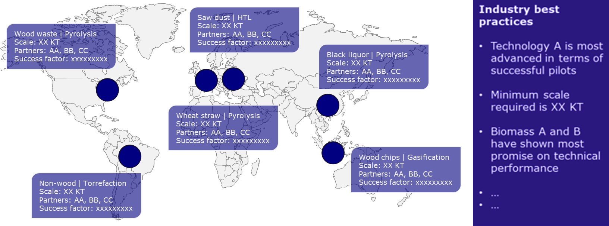
Step 1: Opportunity screening
Industry best practices
Identified best practices from around the globe and contextualized to client’s business case.
SAMPLE OUTPUT

Slide 7
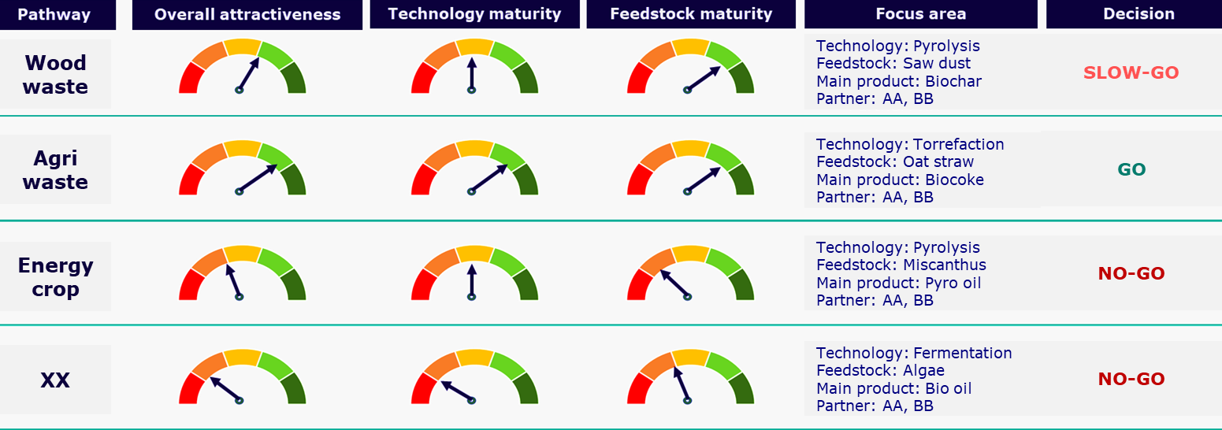
Step 1: Opportunity screening
Prioritization of opportunities
Prioritized feedstock pathways for deep-dive feasibility assessment based on technology and feedstock maturity using a custom balanced scorecard for precise tech-business alignment.
SAMPLE OUTPUT

Slide 8
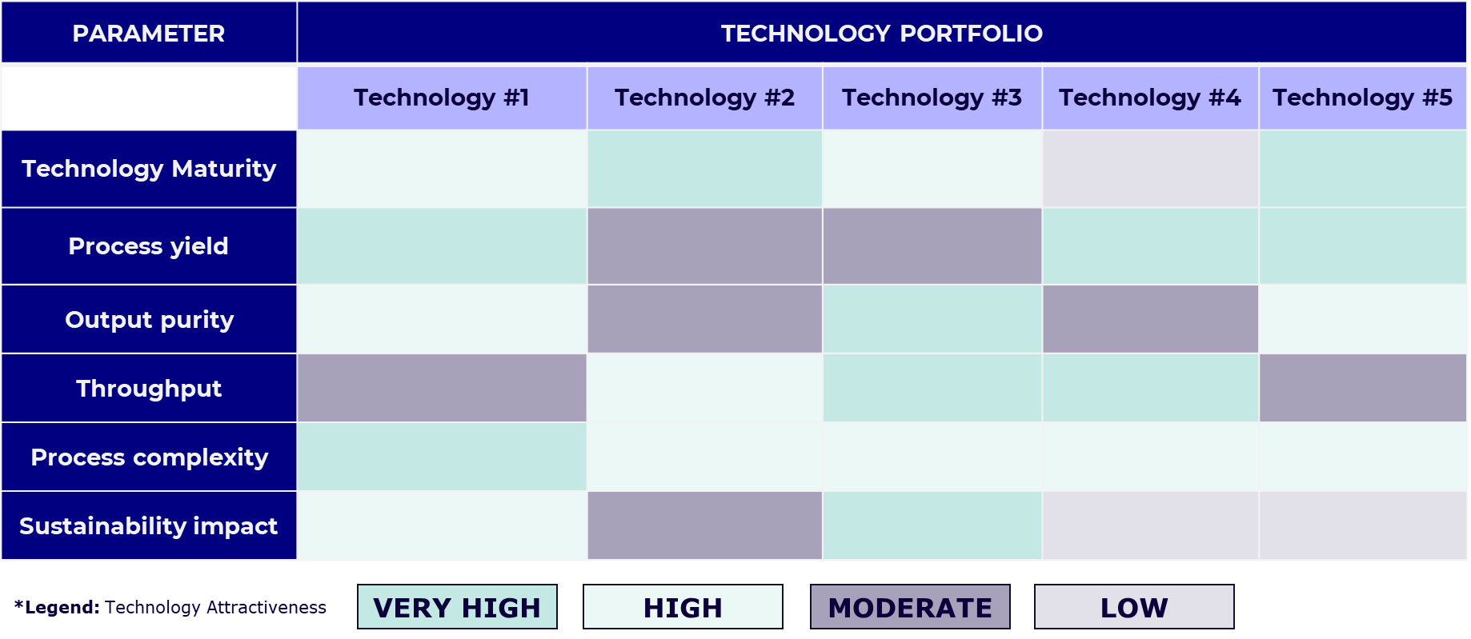
Step 2: Go, no-go, slow-go decision
Technology benchmarking
Evaluated technical attractiveness of selected technologies based on defined KPIs.
SAMPLE OUTPUT

Slide 9
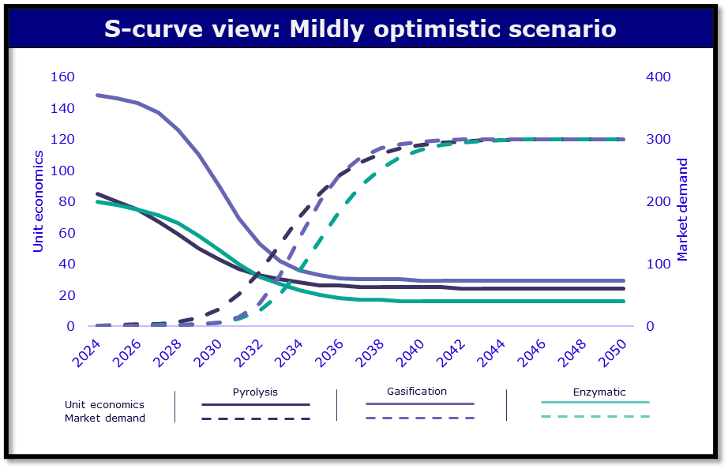
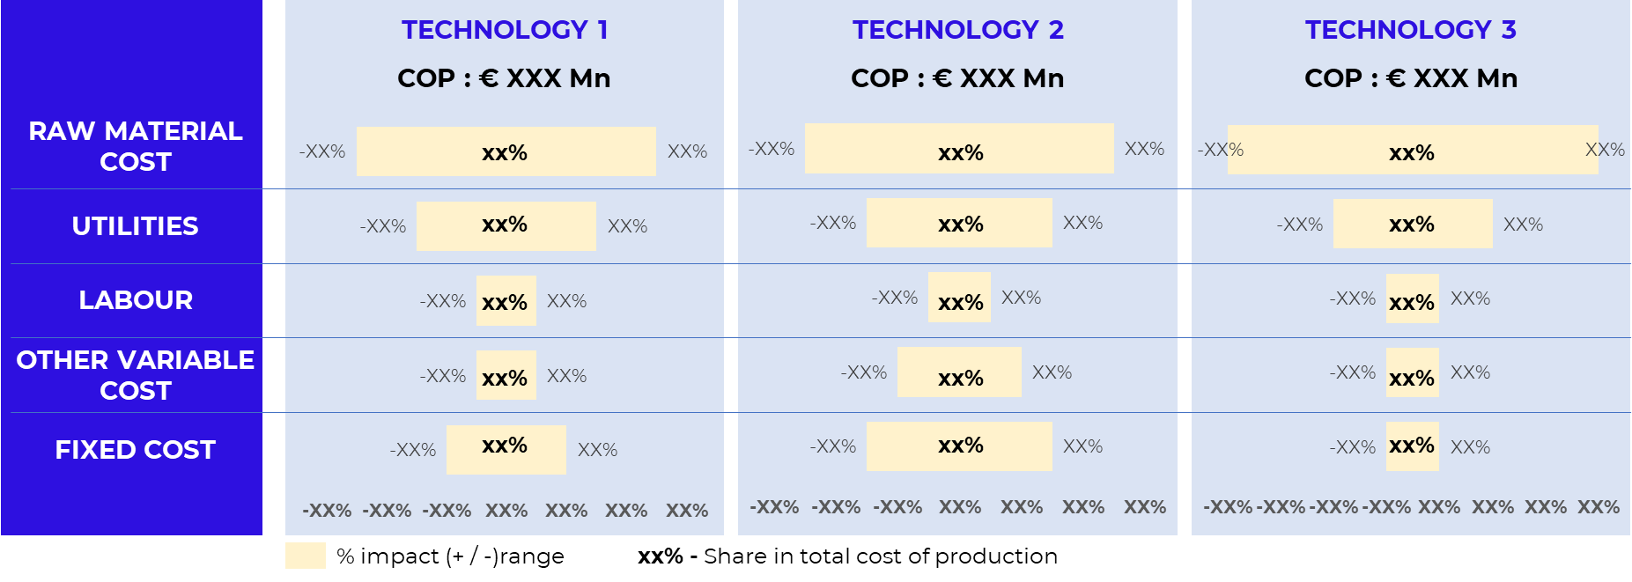
Step 2: Go, no-go, slow-go decision
Techno-economic viability
Unit economics sensitivity analysis
Identified relevant technology adoption bets based on demand pull, unit economics, scale, and ROI. Leveraged in-house tools on technoeconomic scenario modeling and parametric sensitivity analysis.
SAMPLE OUTPUT

Slide 10
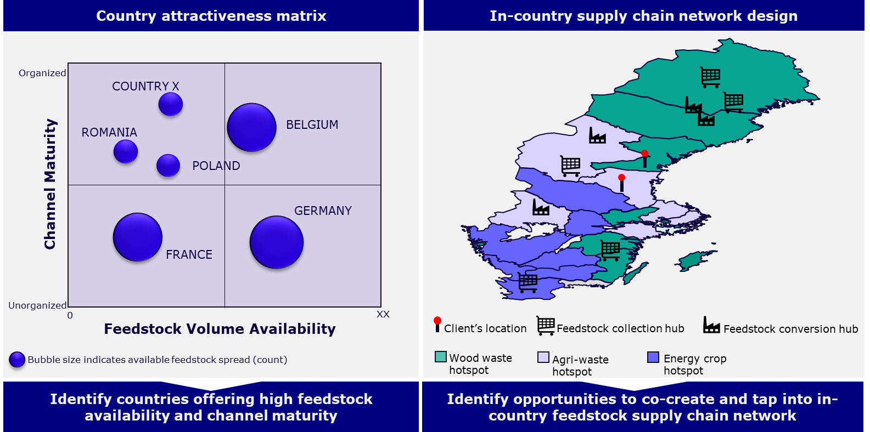
Step 2: Go, no-go, slow-go decision
Supply chain feasibility
Compared the ‘as-is’ and ‘to-be’ states of supply chain maturity and identified opportunities to leverage through on-the-ground partnership development options.
SAMPLE OUTPUT

Slide 11
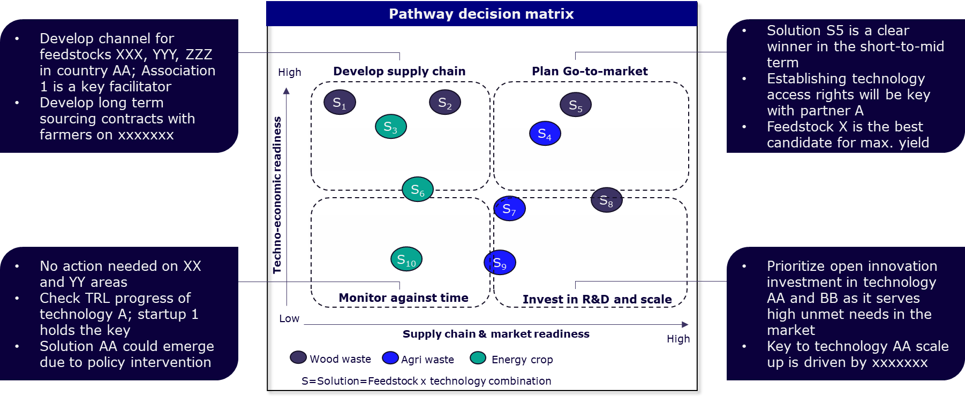
Step 2: Go, no-go, slow-go decision
Go/no-go/slow-go decision
Arrived at go/no-go/slow-go decision based on techno-economic and market readiness for potential solution options in the short-to-mid term horizon.
SAMPLE OUTPUT

Slide 12
Step 3: Go-to-market strategy
Partner due-diligence
Identified, qualified, and selected best-fit partners through a KPI-driven custom scorecard for feedstock security, technology acquisition, and offtake agreements for side streams to ensure successful go-to-market.
SAMPLE OUTPUT

Slide 13
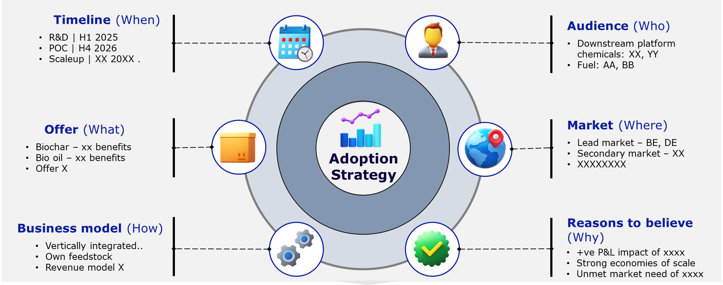
Step 3: Go-to-market strategy
Go-to-market roadmap
Developed a go-to-market strategy for successful adoption of bioenergy and positive P&L impact enabled through a series of client workshops to create enterprise impact.
SAMPLE OUTPUT

Slide 14
Methodology
The FSX Sustainable-Growth-as-a-Service™ Methodology
Innovation & Technology
Supply Chain
Partnership & Ecosystem
Potential vs. scale
Technical vs. Capital readiness
Risk vs. Reward
Policy & Regulation
Techno-economics
Digitalization
Carrots vs. Sticks
Tipping points vs. ROI
Time-to-market vs. Payback period
Connected, systems-level thinking to identify the tipping points and solutions that matter.
14

Slide 15
Are you ready to grow sustainably?
Connect with us.
To request more information such as a meeting, demo, trial, or referral, please visit our website: www.futurescalex.com or email contact@futurescalex.com
At FutureScaleX, we believe that the future of business lies in sustainable growth. Our six-lens methodology is more than just an approach—it's a movement towards a more resilient and sustainable future.
Mumbai
Singapore
Amsterdam
Boston
Floor 8th, Plot 368, Vivaria Tower Bhandarkar Rd, Matunga Phul Market, Mumbai 400019 India
1 North Bridge Road, #18-06 High Street Centre, Singapore, 179094
Transistorstraat 31, 1322 CK Almere, The Netherlands
44 School Street, Ste. 505 Boston, MA 02108 USA
futurescalex.com
futurescalex.com
futurescalex.com
futurescalex.com
contact@futurescalex.com
contact@futurescalex.com
contact@futurescalex.com
contact@futurescalex.com

